Slide 1
Chapter 1: Introduction

Slide 2
What is an Operating System?
What is an Operating system?
  A program that acts as an intermediary between a user of a computer and the computer hardware.
  Resource allocator
  Control Program
Operating system goals:
  Execute user programs and make solving user problems easier
  Make the computer system convenient to use
  Use the computer hardware in an efficient manner
An operating system is the one program that is running at all the times on the computer- usually called the kernel.(System programs and application programs)

Slide 3
Computer System Structure
Computer system can be divided into four components
  Hardware – provides basic computing resources
    CPU, memory, I/O devices
  Operating system
    Controls and coordinates use of hardware among various applications and users
  Application programs – define the ways in which the system resources are used to solve the computing problems of the users
    Word processors, compilers, web browsers, database systems, video games
  Users
    People, machines, other computers

Slide 4

Four Components of a Computer System

Slide 5
Operating System Definition
To understand more fully the OS role, we explore OS from 2 view points.:
User view: In single user, it should be easy to use.
In other cases, where users access the same user through different terminals, More emphasize is on resource allocation and utilization.
System View:
OS is a resource allocator
  Manages all resources
  Decides between conflicting requests for efficient and fair resource use
OS is a control program
  Controls execution of programs to prevent errors and improper use of the computer

Slide 6
Operating-System Operations
Modern OS s are Interrupt driven. If no process, no I/o devices, No users Os will sit quietly waiting for some event to occur.
Hardware generates interrupt and..
Program or software send generate events by using system calls. Error or request by a software creates exception or trap
  Division by zero, request for operating system service
Since OS and users share h/w, s/w resources, we make to sure that an error in a program does not affect any other program.
Dual-mode operation allows OS to protect itself and other system components
  User mode and kernel mode
  Mode bit provided by hardware
    Provides ability to distinguish when system is running user code or kernel code
    Some instructions designated as privileged, only executable in kernel mode
    System call changes mode to kernel, return from call resets it to user

Slide 7

Transition from User to Kernel Mode

Slide 8

Computer System Organization
Computer-system operation
  One or more CPUs, device controllers connect through common bus providing access to shared memory
  Concurrent execution of CPUs and devices competing for memory cycles

Slide 9
TYPES OF OS: Batch Systems
Early computers were Physically enormous machines run from a console
The common input devices were card readers and tape drives.
The common output devices were line printers, tape drives, and card punches.
The user did not interact directly with the computer systems. Rather, the user prepared a job -which consisted of the program, the data, and some control information about the nature of the job (control cards)-and submitted it to the computer operator. The job was usually in the form of punch punch cards. At some later time (after minutes, hours, or days), the output appeared.
To speed up processing, operators batched together jobs with similar needs and ran them through the computer as a group.

Slide 10
Multiprogrammed OS
  needed for efficiency
  Single user cannot keep CPU and I/O devices busy at all times
  Multiprogramming organizes jobs (code and data) so CPU always has one to execute
  A subset of total jobs in system is kept in memory
  One job selected and run via job scheduling
  When it has to wait (for I/O for example), OS switches to another job

Slide 11
Timesharing OS
Timesharing (multitasking) is logical extension in which CPU switches jobs so frequently that users can interact with each job while it is running, creating interactive computing
  Each user has at least one program executing in memory process
  If several jobs ready to run at the same time  CPU scheduling
  If processes don’t fit in memory, swapping moves them in and out to run
  Virtual memory allows execution of processes not completely in memory

Slide 12
Multiprocessing OS
Most systems to date are single-processor systems; that is, they have only one main CPU.
However, multiprocessor systems (also known as parallel systems or tightly coupled systems) are growing in importance.
Such systems have more than one processor in close communication, sharing the computer bus, the clock, and sometimes memory and peripheral devices.
Multiprocessor systems have three main advantages:
Increased throughput.
Economy of scale.
Increased reliability.

Slide 13
Distributed Systems
A network, in the simplest terms, is a communication path between two or more systems. Distributed systems depend on networking for their functionality. By being able to communicate, distributed systems are able to share computational tasks, and provide a rich set of features to users.
CLIENT SERVER SYSTEMS
PEER TO PEER SYSTEMS

Slide 14
Real time embedded systems:
→Embedded computers are most prevalent form of computers in existence.
→these are found everywhere ex: robots, microwave oven. Now a days entire house can be made computerized. Used in alarm systems, coffee makers, CCTV cameras etc. They tend to have specific tasks.
→OS has limited features.
→ have little user interface.
these systems run Real time OS.
Rigid time constraints. Processing must be done within that time constraint.
Used as a control device for a specific application.

Slide 15
Handheld systems:
Include PDAs(Personal digital assistants). Such as palm and pocket PCs, cell phones.
More challenging.
Limited size, weight.
Small memory, slow processor, small display screens.
Only a small subset of web page is displayed on the handheld device. Known as web clipping

Slide 16
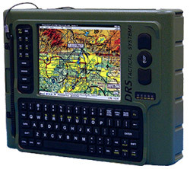
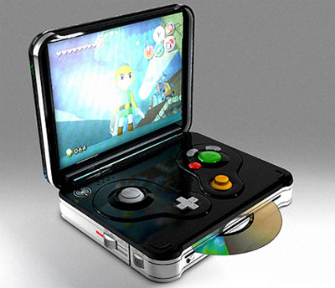

Slide 17

Storage structure and Hierarchy

